Slide 1
MELT: Numbers, Operations, and Meaning
Day 5: Friday June 30

Slide 2
Agenda
8:30 – 10:00 The Path to Equity and Teaching Mathematics for a Growth Mindset
10:00 - 10:30 Break
10:30 - 10:30 Presentations
10:30 - 11:45 Professional Noticing and Wrap Up

Slide 3
Concept Map
Let’s make concept maps of what we have learned about Mathematical Mindsets. It is up to you what you want to include and how you want to organize your map. Clearly, you won’t be able to include everything that you read, so pick what resonated with you!

Slide 4
Professional Noticing

Slide 5
Three Interrelated Stages of Professional Noticing
Attending to a child’s actions
Interpreting what those actions tell you about the child’s mathematical ability
Deciding what are the next best instructional or diagnostic steps
(Jacobs, Lamb, & Philipp, 2010)

Slide 6
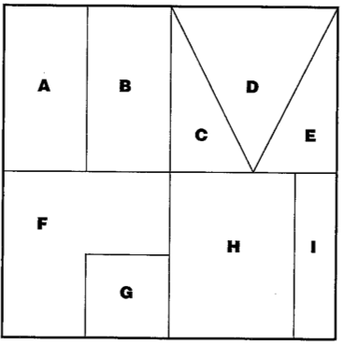
Practice with “Fractions of a Square”
The large outer square represents 1 whole unit. Decide what fraction each piece is in relation to the whole square.
Attending to a child’s actions
Interpreting what those actions tell you about the child’s mathematical ability
Deciding what are the next best instructional or diagnostic steps
Notes:
Have students do this on their own first (use the worksheet). Hold discussion about how students went about figuring this out. Most will use guess-and-check strategy.

Slide 7
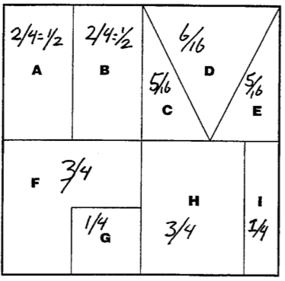
Student A
Attending to a child’s actions
Interpreting what those actions tell you about the child’s mathematical ability
Deciding what are the next best instructional or diagnostic steps

Slide 8
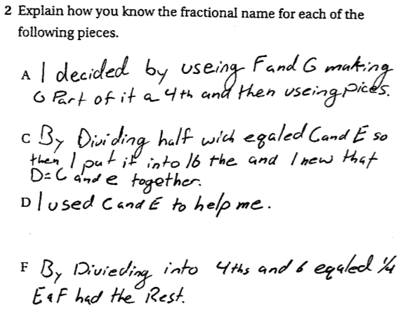
Student A
Attending to a child’s actions
Interpreting what those actions tell you about the child’s mathematical ability
Deciding what are the next best instructional or diagnostic steps

Slide 9
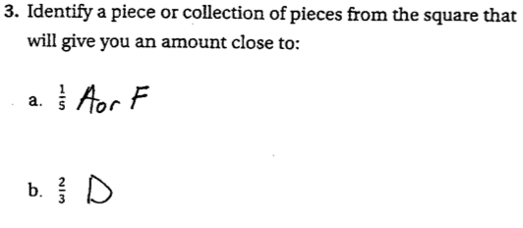
Student A
Attending to a child’s actions
Interpreting what those actions tell you about the child’s mathematical ability
Deciding what are the next best instructional or diagnostic steps

Slide 10
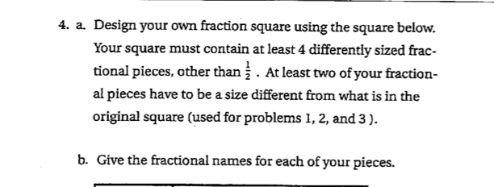
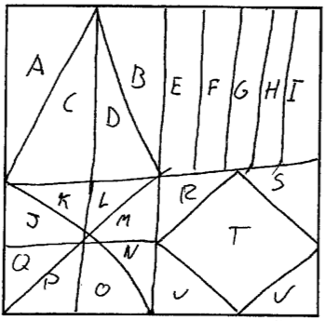
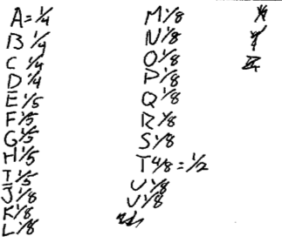
Student A
Attending to a child’s actions
Interpreting what those actions tell you about the child’s mathematical ability
Deciding what are the next best instructional or diagnostic steps

Slide 11
Practice Students B, C, and D
Attending to a child’s actions
Interpreting what those actions tell you about the child’s mathematical ability
Deciding what are the next best instructional or diagnostic steps
Notice for tasks
What order would you have the students share their solutions for a whole class discussion and why?
What is your mathematical agenda?
Notes:
Use Noticing_WS

Slide 12
After Noticing…
What order would you have the students share their solutions for a whole class discussion and why?
What is your mathematical agenda?

Slide 13
References
Middle Grades Assessment: Package 1 (1999)
Mathematics Teacher Noticing: Seeing through teachers’ eyes (2011)
Common Core State Standards for Mathematics (2010)
Boaler, J. (2016). Mathematical mindsets. San Francisco, CA: Jossey-Bass.

